Slide 1


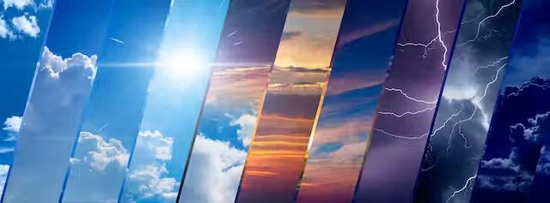

Weather forecast model based ANN
Guide: Dr. Rajesh Kadu
PRESENTATION BY G-16

Slide 2
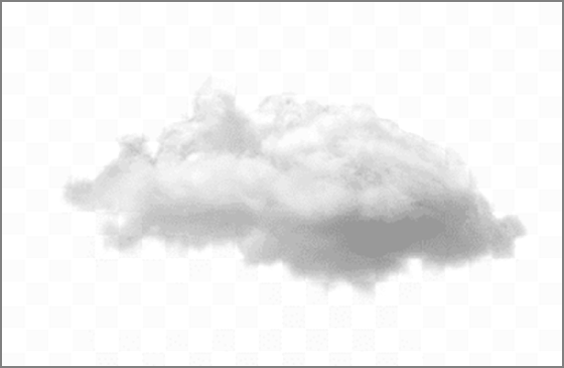

Weather forecast
BY:
AMRUTA
AMEY
DATTATRAY
SIDDHESH

Slide 3
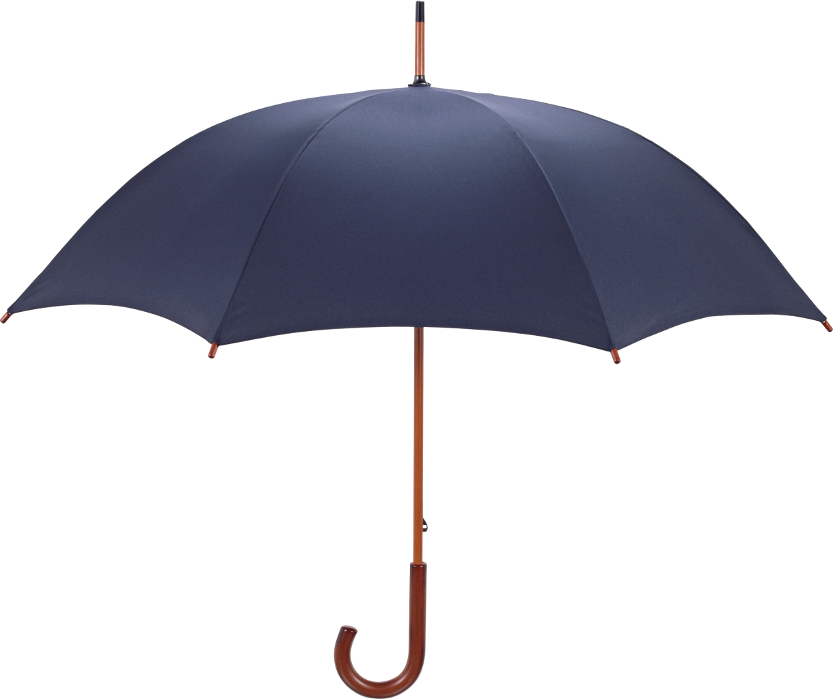

Weather forecast
PRESENTATION OUTLINE
Weather forecast
INTRODUCTION
EXSISTING SYSTEM
PROPOSED SYSTEM
PROPOSED SYSTEM ADVANTAGES
PROPOSED SYSTEM SPECIFICATION
DATA FLOW DIAGRAM
GUI
CODE
FUTURE SCOPE
CONLUSION
S VB BK DFBAS;SED,B;S[FGLB;ADF.;.;

Slide 4
INTRODUCTION
Weather forecasting is a process of identifying and predicting to certain accuracy the climatic conditions using multiple technologies
Nowadays there are many approaches we are using for weather forecasting. Mathematical modeling, statistical modeling and artificial intelligence techniques are some of them.
We are using ANN which is based on smart analyzing the trend from historical data. The other models are accurate in calculation but not in predictions the can not able to adapt the irregular patterns of data which can neither be written in form of function or deducted as formula

Slide 5

PROPOSED SYSTEM
EXISTING METHODOLOGY and LIMITATIONS
Mathematical modelling:A mathematical technique called discretization is integral to modeling an enormous and complex physical phenomenon like weather. Scientists partition Earth’s atmosphere into thousands of three-dimensional cubes
Statistical modling:Statistical techniques necessarily incorporatyeed the ime lag. That is ,if one wanted to develop a scheme for forecasting the maximum temperature for tomorrow , the input would consist only of observational data available at the time that the forecast was to be made
Machine learing modeling: Applying machine learning to nowcasting, allows us to increase the accuracy and speed of making these predictionsApplying machine learning to nowcasting, allows us to increase the accuracy and speed of making these predictions Applying machine learning to nowcasting, allows us to increase the accuracy and speed of making these predictions

Slide 6
PROPOSED SYSTEM ADVANTAGES
PROPOSED SYSTEM
A typical feed forward with back propagation network should have at least three layers- an input layer, a hidden layer, and an output layer.
Appropriate selection of number of hidden layers and the number of neurons in each of them needs experimentation.
We train the ANN using the NeuralProphet model , a popular training algorithm for the forecasting
It is built on PyTorch and combines Neural Networks and traditional time-series algorithm

Slide 7


PROPOSED SYSTEM ADVANTAGES
Weather forecasting can be done more accurately using ANN. Because daily weather data has multiple parameters such as temperature, humidity, rainfall amount, cloud distance and size, wind speed and direction, etc.
All these parameters are non linear, but they required to be processed together to determine temperature, rainfall, humidity or weather status for the future day.
Such type of applications need complex models and can able to produce the required result by generating the patterns on its own by performing self-learning using the training data given to the model.

Slide 8
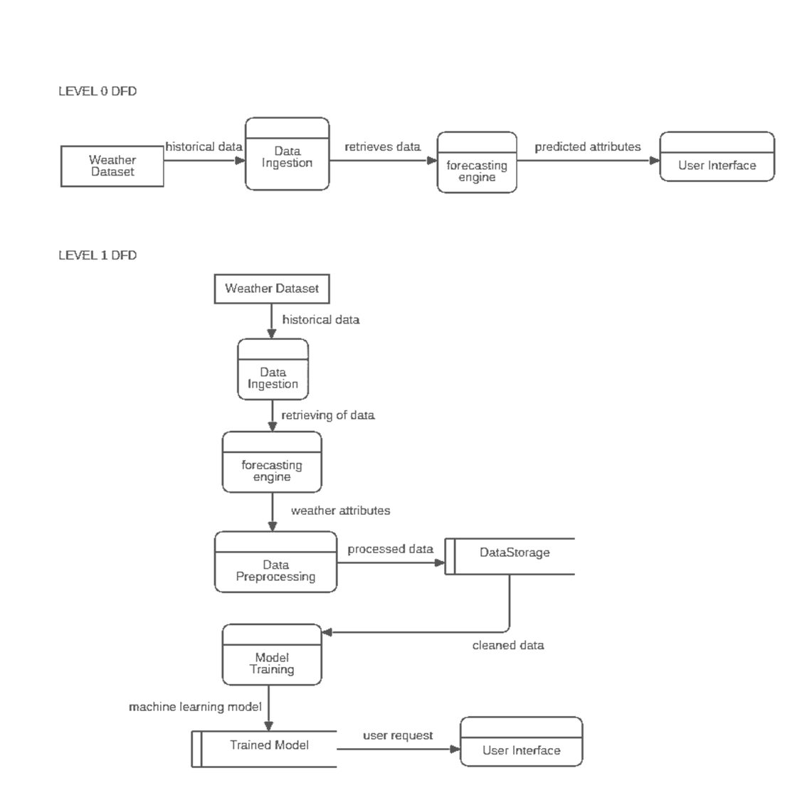

PROPOSED SYSTEM
SPECIFICATION
Hardware requirements | Software requirements | Language used
Processor-13 | Windows-10 or higher | Python
Memory-mim 5GB free | Tkinter , Jupiter
RAM- 8GB | Pychram or Vscode

Slide 9

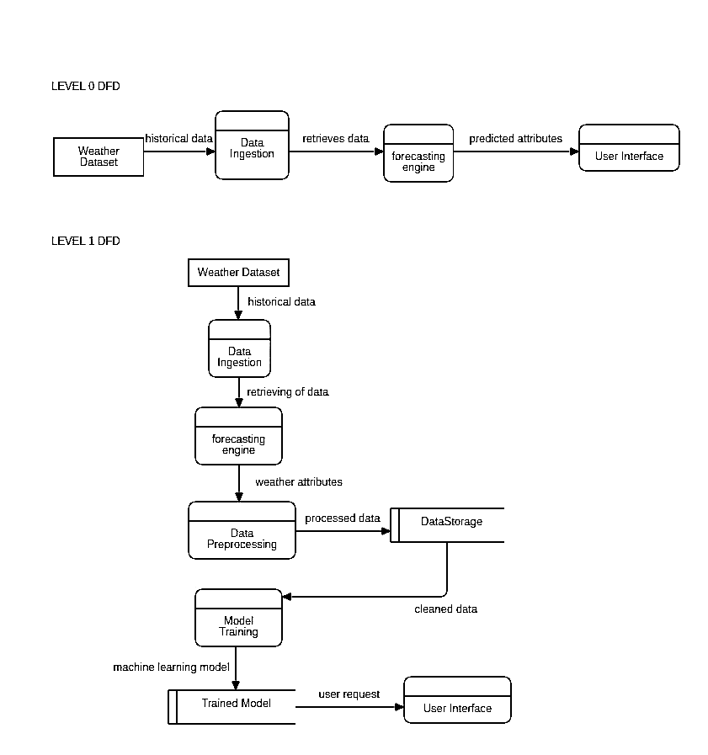
DATA FLOW DIAGRAM

Slide 10

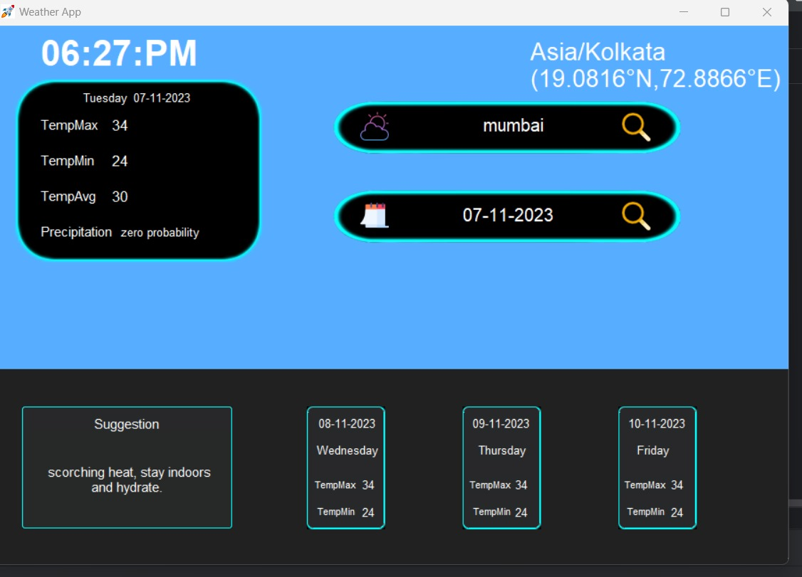
GUI

Slide 11
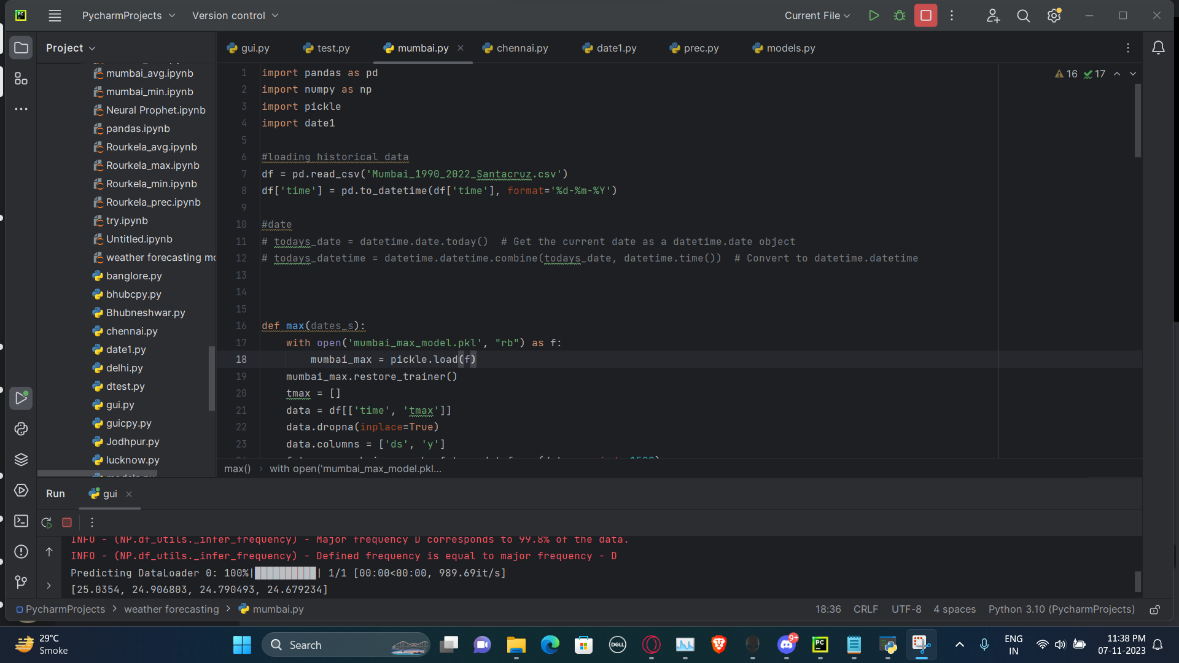
FUTURE SCOPE
CODE

Slide 12

FUTURE SCOPE
Scope of Weather Prediction
Our system will only provide weather prediction of Amabla only.
Prediction will be done based on historical weather activities like based on past temperature, wind, etc. pattern what will be the future weather.
Future Enhancement
Mobile and IOS application Integration.
Addition of new cities weather dataset to predict there future weather also.
Addition of new Indices.
Animation like snow and functions like notifications can also be added.

Slide 13

LANGUAGE USED
The project is mainly consist of Python and its various labiraries
The frontend is made using tkinter(the whole styling of application was done only by tkinter
Backend (main module) uses ANN algorithm Neural Prophet

Slide 14
CONCLUSION
In the past decade, the field of extreme event attribution has made great strides in understanding and explaining extreme events in the context of climate change. This is still an emerging science, however; thus, continued research is required to increase the reliability of event attribution results, particularly for event types that are presently poorly understood. The need for improved understanding is coming at a time when there is increasing inquiry by the public, policy makers, and practitioners about the relationship between specific weather events and climate changeNational Academies of Sciences, Engineering, and Medicine. 2016. Attribution of Extreme Weather Events in the Context of Climate Change.

Slide 15


